Slide 1


“There can be no greater gift then that of giving one’s time and energy
to help others without expecting anything in return”
– Nelson Mandela

Slide 2

Tips & Tools for Making 'Iconic' Power Apps
Paddy Byrne - Power Platform Functional Consultant

Slide 3
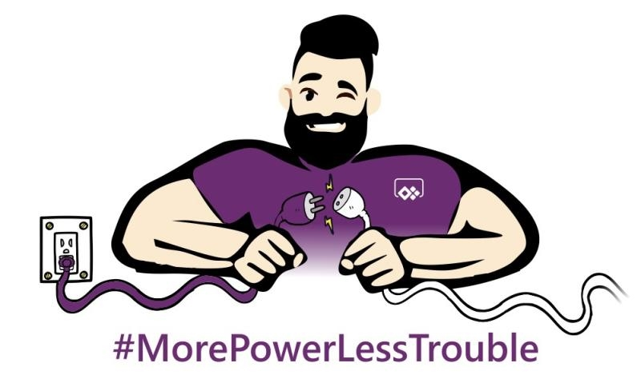
Tips & Tools for Making ‘Iconic’ Power Apps
Paddy Byrne
#EmPowerYourCareer
Notes:
Working with Microsoft business applications since 2009
Helpdesk Support Engineer using CRM 4.0
I was a citizen developer – solved business problems within my support team
Dynamics 365 for Sales and Customer service
Only in the last year, with my pivot from Dynamics 365 to Power Apps that I’ve really had the opprtuntunity to explote my creative side

Slide 4
Session Objectives
Understand the Importance of Using Icons Correctly
Provide you With the Tools to Create Unique Icons
Prove that you can Develop Professional Looking Power Apps Without the Need for Design Experience or Expensive Software
#EmPowerYourCareer
Notes:
Current landscape – user experience more important than ever.
Icons and graphics improve user experience

Slide 5
Agenda
Why Care about Icon Use and What Icons Are?
Some Generic Icon Usage
Four (Almost Free) Tools
Where Icons are Used
Demonstrate Where to Find Icons of the Right Size and How to Upload Them
Get Creative with Canvas Apps
Call to Action
#EmPowerYourCareer

Slide 6

Importance of Icons
x 60,000
#EmPowerYourCareer
Notes:
Research shows that the brain process visuals 60,000 times faster than text?
Icons will be the first thing that your users will notice about your app
Remember that you don’t get a second chance to make a first impression

Slide 7
Correct Use of Icons
What is an icon?
“An image that represents an application, a capability, or some other concept or specific entity with meaning for the user”*
#EmPowerYourCareer
* https://whatis.techtarget.com/
Notes:
Key here is that it must mean something to the user
Icons should tell a story, they provide instructions on what to do next or information on what may happen next within the flow of your app.

Slide 8

Correct Use of Icons
Play Media
#EmPowerYourCareer
Notes:
Look at some different icons – figure out what story they’re trying to tell

Slide 9

Correct Use of Icons
Save
#EmPowerYourCareer

Slide 10

Correct Use of Icons
Home
#EmPowerYourCareer

Slide 11

Correct Use of Icons
Home?
Church?
Up?
#EmPowerYourCareer
Notes:
Preserved as home, or

Slide 12

Correct Use of Icons
Home?
River?
#EmPowerYourCareer
Notes:
Added detail to it that is unnecessary and this can easily confuse the user

Slide 13

Correct Use of Icons
Share?
Logout?
Export
#EmPowerYourCareer

Slide 14

Correct Use of Icons
Save?
Attach?
Save All Attachments
#EmPowerYourCareer
Notes:
Causes confusion because it combines to other very common icons

Slide 15

Correct Use of Icons
Caterpillars?
Reverse Sort
#EmPowerYourCareer

Slide 16
Correct Use of Icons
Export
Save All Attachments
Reverse
#EmPowerYourCareer
Notes:
Of the last three icons none of them are necessarily bad icons.
In fact, once you know what they are they’re very clever icons, they’re just very easy for users to take out of context

Slide 17
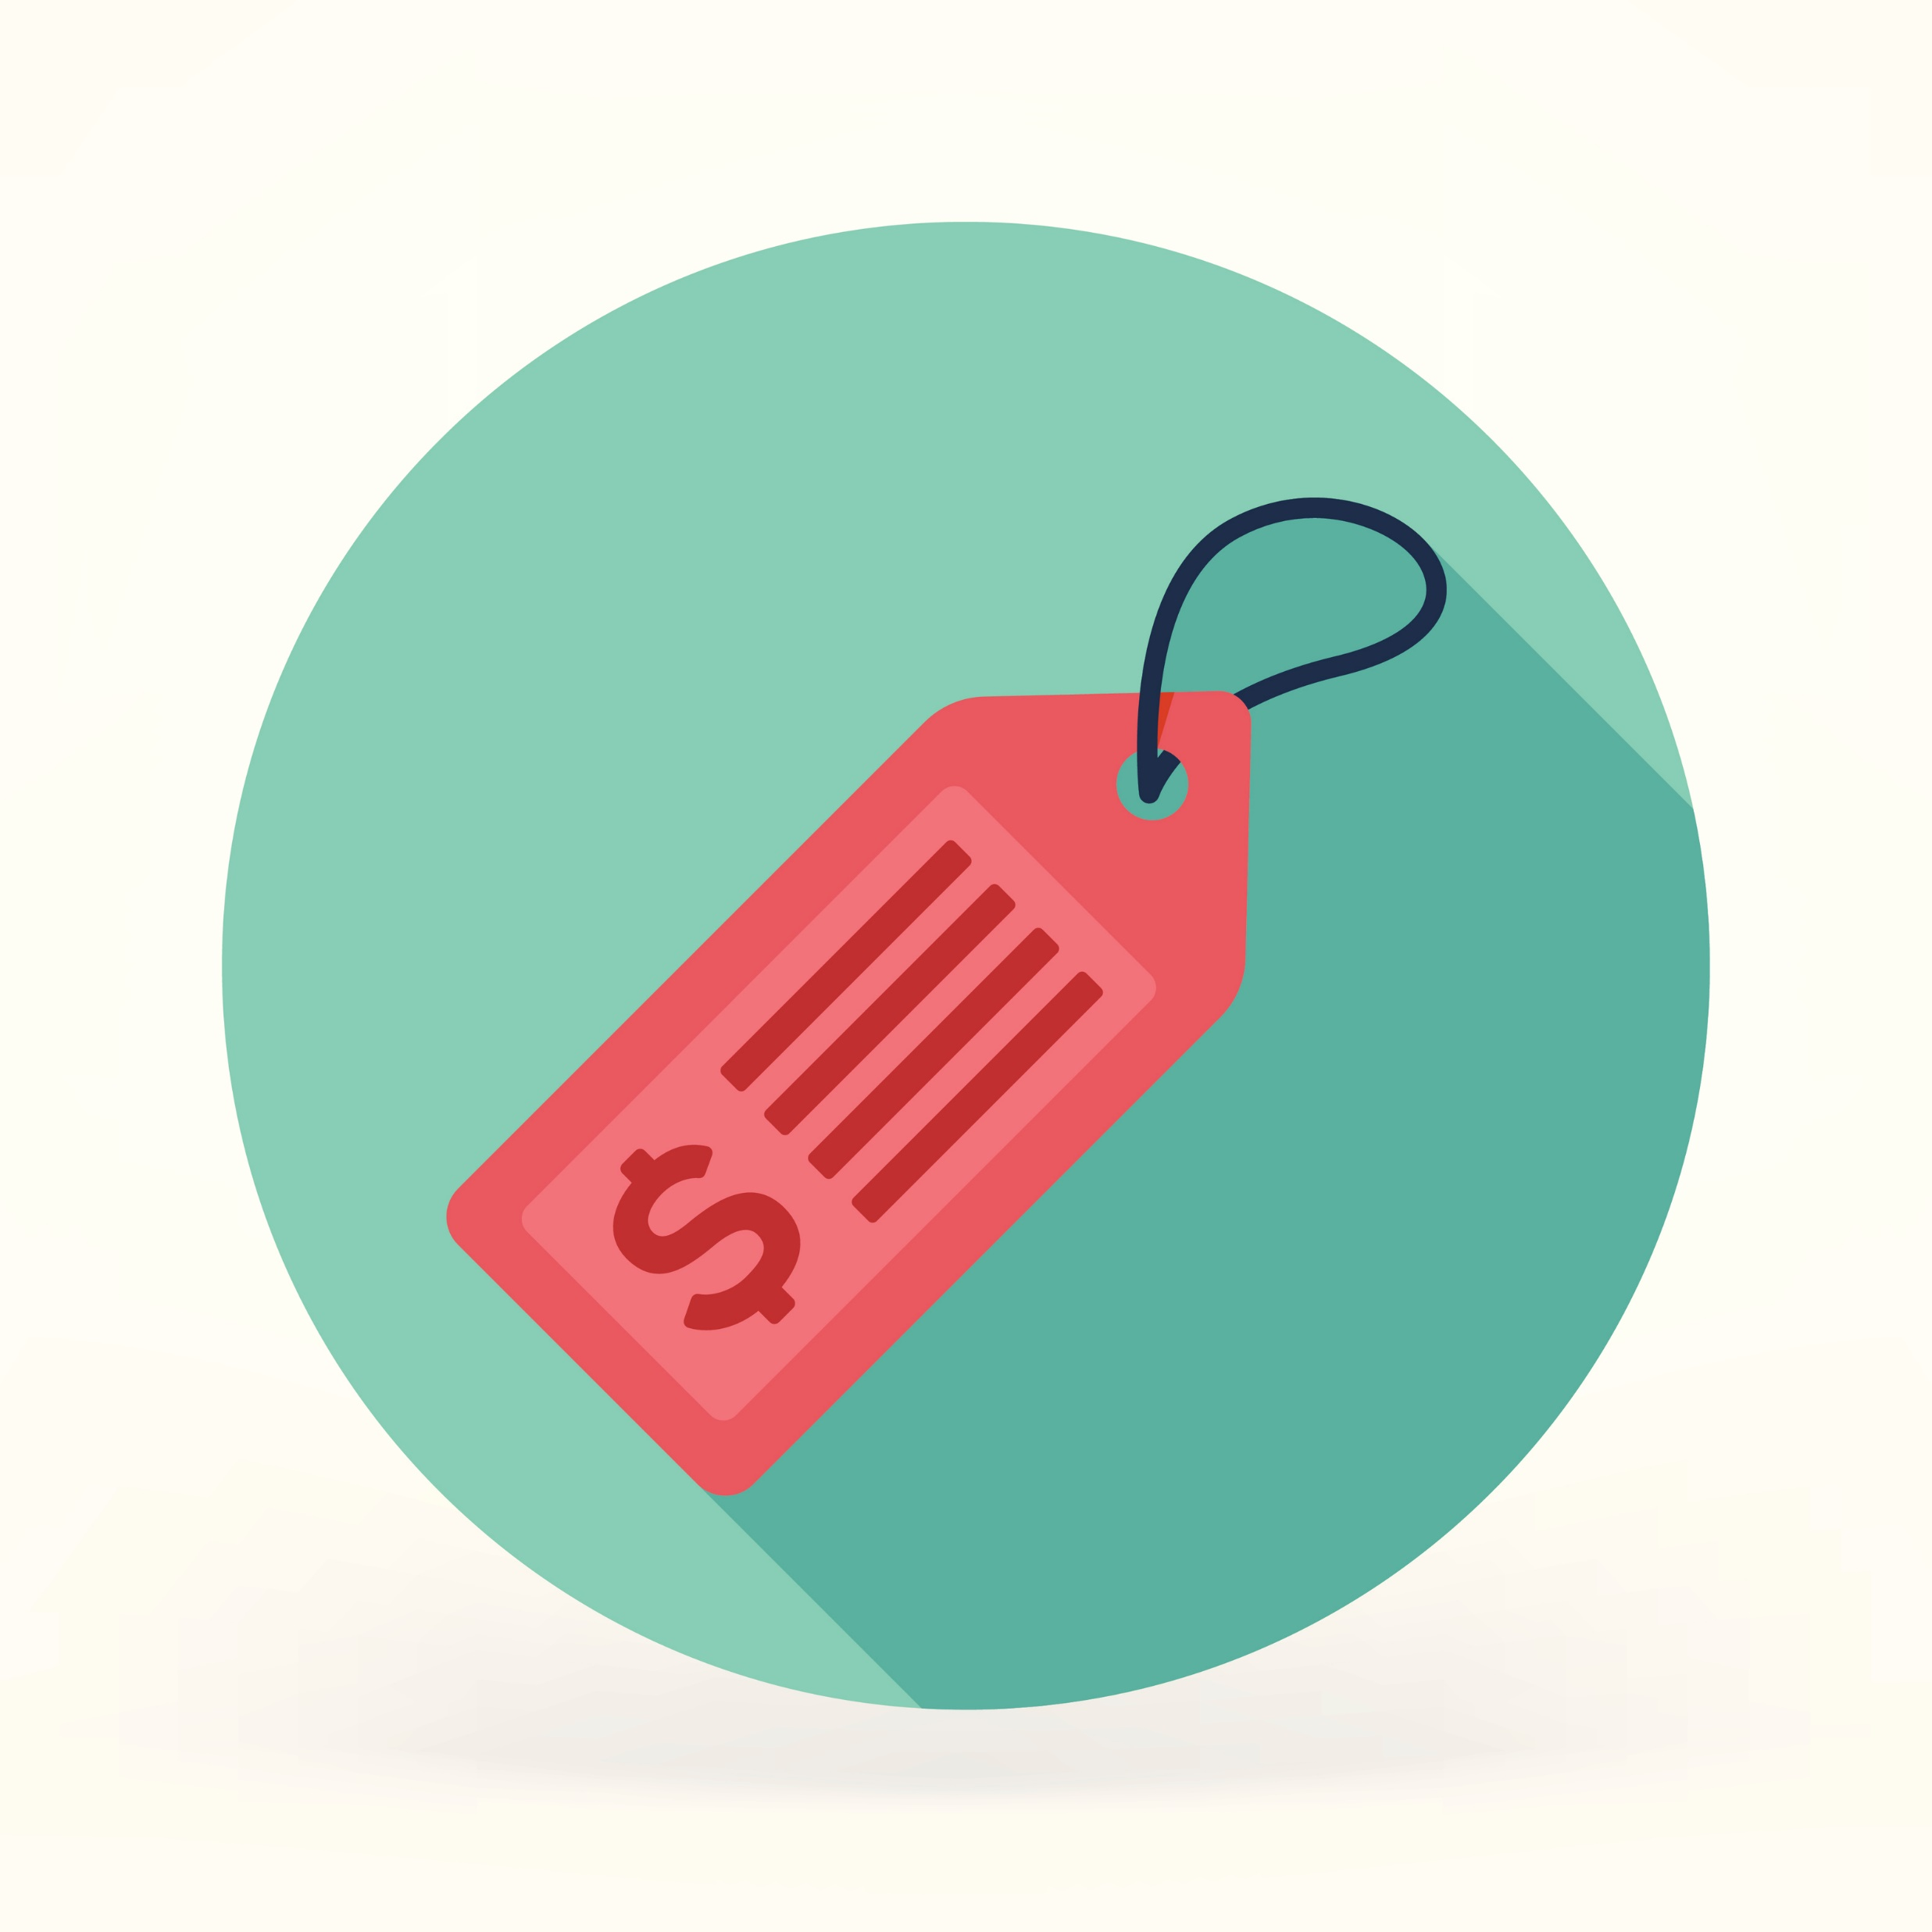
Labels
#EmPowerYourCareer
Notes:
Icons work better if they have labels
Issue is that labels cost screen real estate think mobile phone
Advantage of not using labels is that you’re application is automatically universal
Disadvantages are that if using icons that are not globally recognisable, you’re app may be confusing for your users and difficult to operate

Slide 18

Labels
#EmPowerYourCareer
Notes:
The biggest mistake you can make when using icons is to assume that the users know what the icons mean.
Microsoft learned this lesson the hard way when they released a version of Outlook that had icons only in the toolbar.
This resulted in poor user experience and it wasn’t long before Microsoft released an update which added text labels to the icons.

Slide 19

Accessibility
#EmPowerYourCareer
Notes:
Regardless of whether you choose to use labels or not, remember to make you application accessible.
Ensure you use large enough icons to increase the touch target of your users
Take the use of screen readers into consideration so add accessible labels to your controls where needed.

Slide 20



Mood
Set the Mood
Simple,
Corporate
Friendly,
Modern
Enjoyable,
Funny
#EmPowerYourCareer
Notes:
Glyph style – Simple, Corporate
Linear Style – Friendly, Modern
Flat Style – Enjoyable, Funny
You wouldn’t want to mix styles

Slide 21

Tools
#EmPowerYourCareer

Slide 22
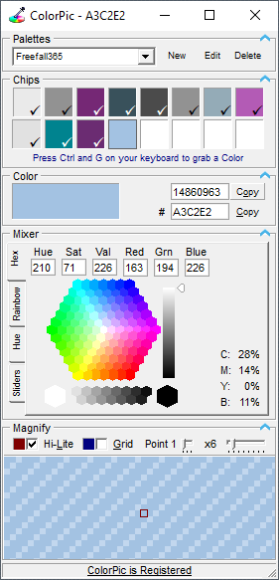

ColorPic from Iconico
http://www.iconico.com/download.aspx?app=ColorPic
Cost: $7.50
#EmPowerYourCareer
Notes:
Eyedropper App
Built in Magnifier
Grab and Store Colours
Create your Own Colours
Provides a lot of Information about the colour
Allows you to Save Palettes

Slide 23

Iconator from MscrmTools
https://www.xrmtoolbox.com/
Cost: Free
#EmPowerYourCareer
Notes:
Build by the community for the community
Top Useful Features
Load Entities and Images from a Common Data Service database.
Automatically Create Web Resources
Map Web Resources to Entities as Icons

Slide 24

Metro Studio from Syncfusion
https://www.syncfusion.com/downloads/metrostudio
Cost: Free(ish)
#EmPowerYourCareer
Notes:
Top Useful Features
7,000+ Flat and Wireframe Icons
Continuously Updated
All Icons are Customisable
Export as .png or .svg

Slide 25
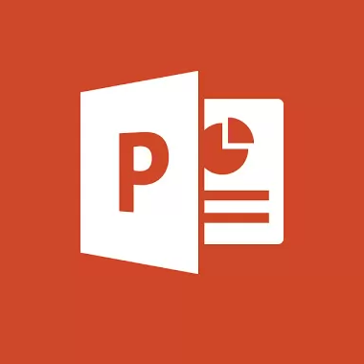
PowerPoint
Office 365
Cost: Variable (Comes with Office 365)
#EmPowerYourCareer
Notes:
Top Useful Features
Categorised Catalogue of Icons
Add Styles and Colours
Add effects such as Gradients and Shadows
Support for .svg

Slide 26
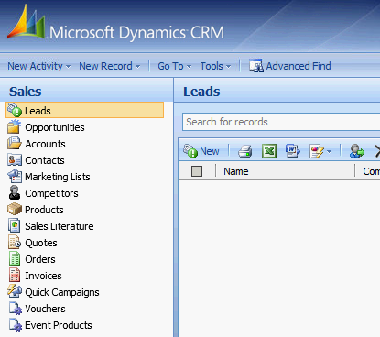
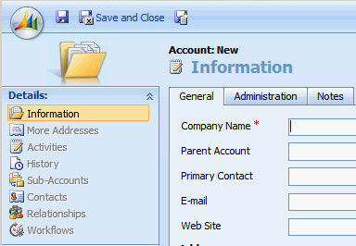
Icons Through the Ages
CRM 4.0 2009
16x16 GIF
32x32 ICO
66x48 GIF
#EmPowerYourCareer
Notes:
I like a trip down nostalgia lane
Remind myself how the Dynamics CRM product has evolved into Power Apps
Also, as a new citizen developer you may already work with some sort of Power App

Slide 27
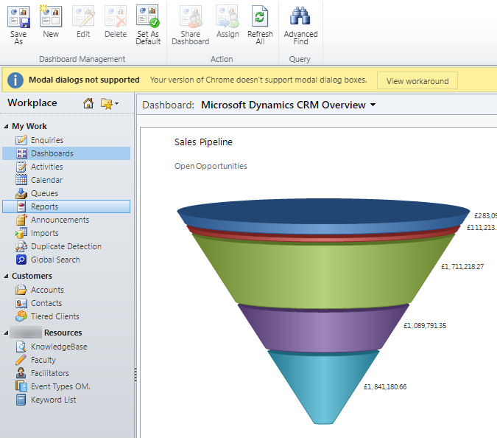
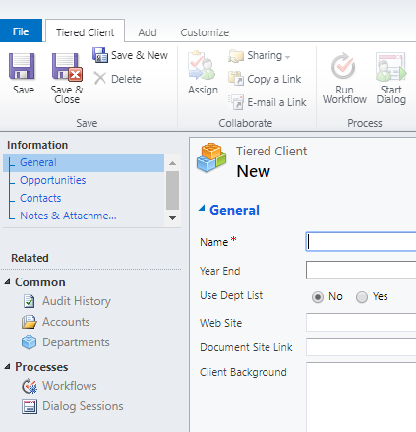
Icons Through the Ages
CRM 2011
16x16
32x32 PNG, GIF or JPG
#EmPowerYourCareer
Notes:
First Tool – The Iconator was Created

Slide 28
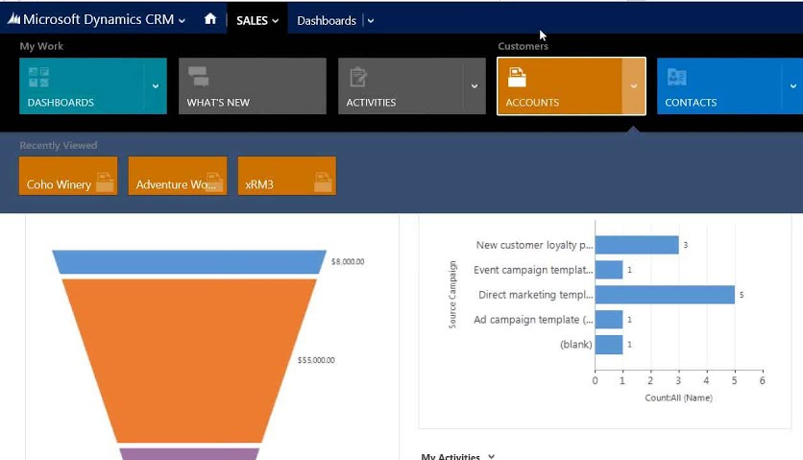
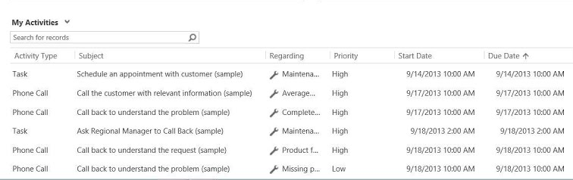
Icons Through the Ages
CRM 2013
32x32
16x16 PNG, GIF or JPG
White: #FFFFFF
Grey: #5D5D5D
#EmPowerYourCareer

Slide 29
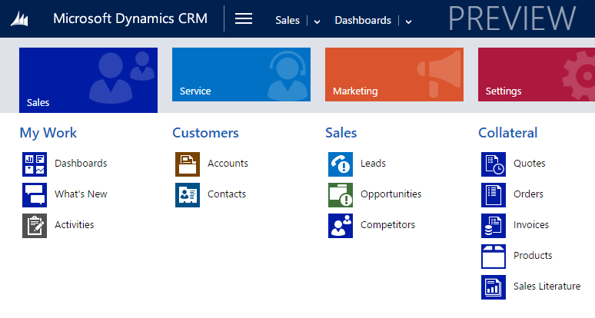
Icons Through the Ages
CRM 2015/CRM 2016 / Dynamics 365
32x32
16x16 PNG, GIF or JPG
White: #FFFFFF
Grey: #5D5D5D
#EmPowerYourCareer

Slide 30

Icons Through the Ages
Power Apps
32x32
16x16 PNG, GIF, JPG or SVG
#EmPowerYourCareer
Notes:
Power Platform came along
Dynamics 365 for Customer Engagement became a model-driven app
Support for SVG was introduced –
SVG has become the preferred format for icons in Power Apps because they scale according to your desire resolution
Unified Interface came to prominence Actually been bubbling away under the hood since 2015.

Slide 31
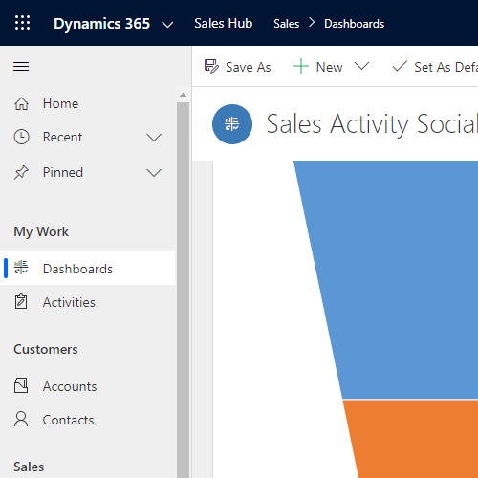
Model-Driven Apps
Power Apps
32x32 SVG
#EmPowerYourCareer

Slide 32
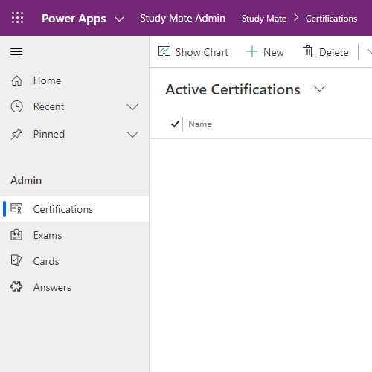
Model-Driven Apps
Power Apps
32x32 SVG
#EmPowerYourCareer

Slide 33
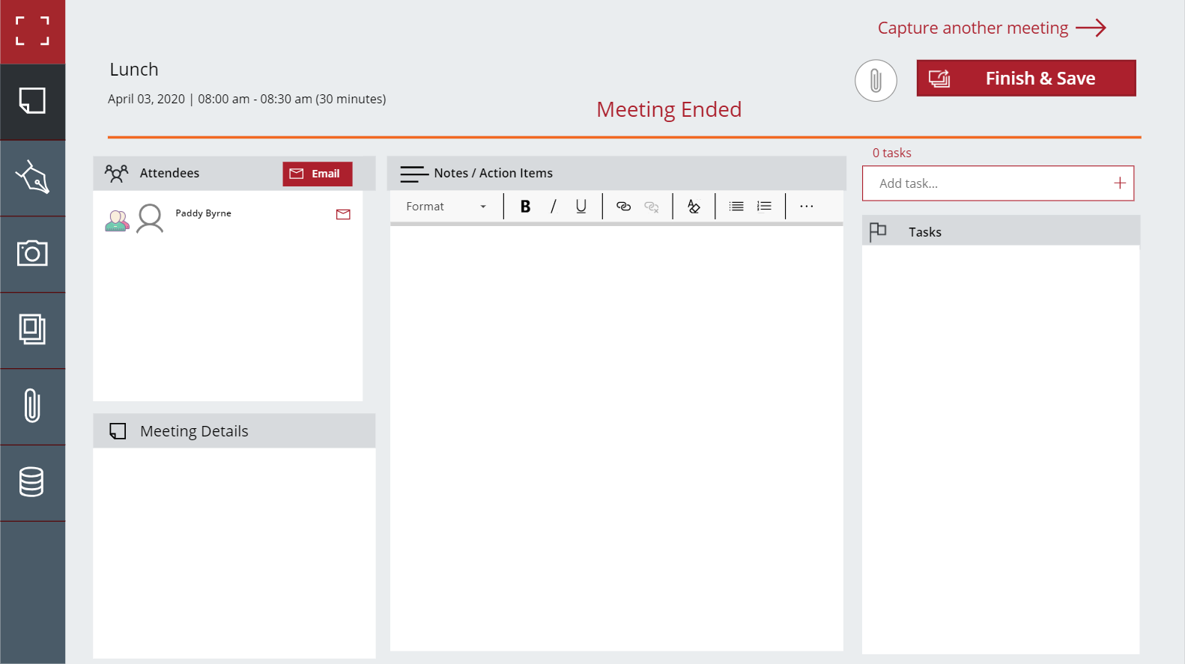
Canvas Apps
Anything Goes
Meeting Capture V2 by Reza Dorrani
https://powerusers.microsoft.com/t5/Community-App-Samples/Meeting-Capture-V2/td-p/342028
#EmPowerYourCareer
Notes:
Icon rich canvas apps can be

Slide 34
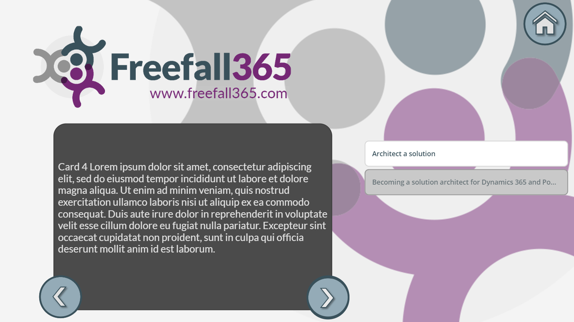
Canvas Apps
Anything Goes
#EmPowerYourCareer

Slide 35
Demo
DEMO
#EmPowerYourCareer

Slide 36
Summary
You Don’t Need Design Experience or Expensive Tools to Create ‘Iconic’ Power Apps
#EmPowerYourCareer

Slide 37
Call to Action
Create a 30-Day Power Apps Trial https://www.nz365guy.com/learning-the-microsoft-power-platform-setting-up-a-power-apps-trial-environment/
Pick a Topic
Build a basic Model-Driven App - https://docs.microsoft.com/en-us/powerapps/maker/model-driven-apps/build-first-model-driven-app
Add Some Data
Display the data in a Canvas App - https://youtube.freefall365.com
Use custom icons in the canvas app
Tweet a screenshot tagging @PaddyFreefall #EmPowerYourCareer
#EmPowerYourCareer
Notes:
E.g

Slide 38
Q&A
#EmPowerYourCareer

Slide 39
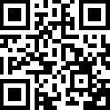
Please fill out
the survey!
#EmPowerYourCareer

Slide 40
Thank You for Attending

